Slide 1
Mechatronics AEZG511
Lecture

Slide 2
Recap of Fundamentals

Slide 3
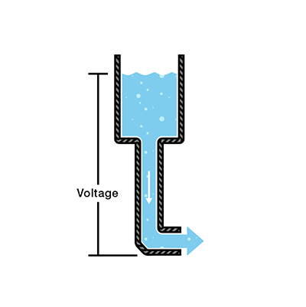
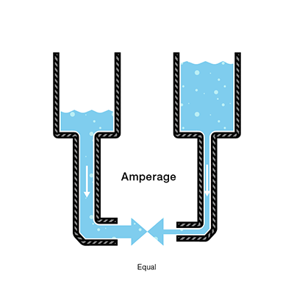
Voltage / Current
Water = Charge
Pressure = Voltage
Flow = Current (Charge per unit time)

Slide 4
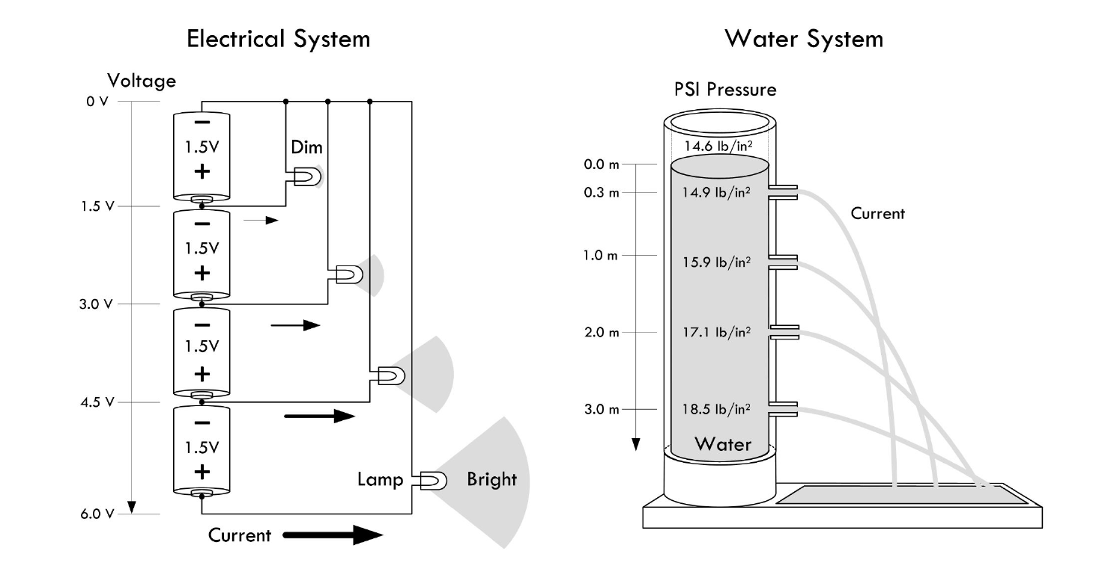
Voltage / Current

Slide 5
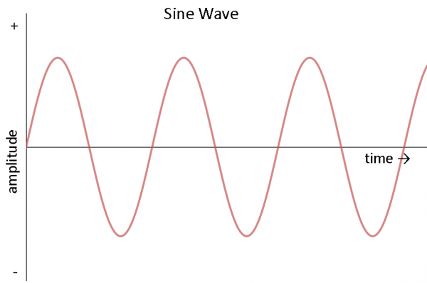
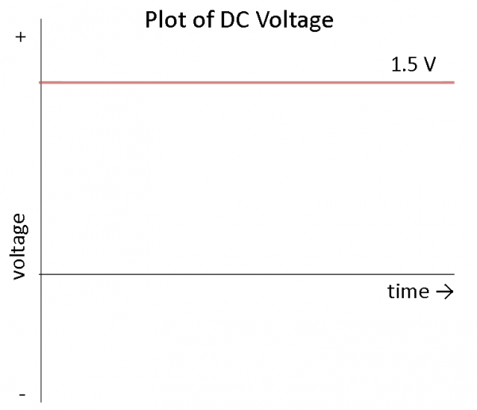
Voltage / Current
AC Voltage

Slide 6
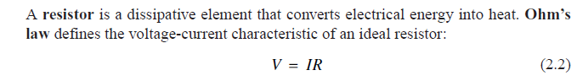
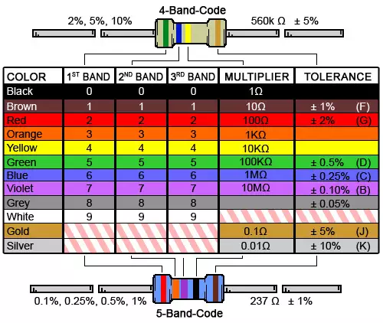
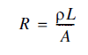
Resistance
5 6 x 10 = 560 Ω
R???

Slide 7
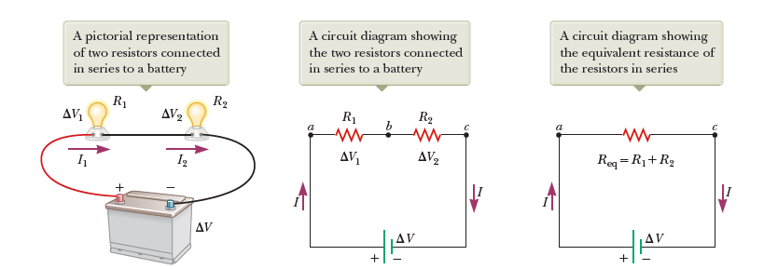
Resistances in Series

Slide 8
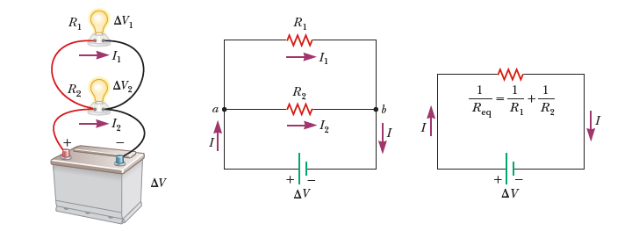
Resistances in Parallel

Slide 9
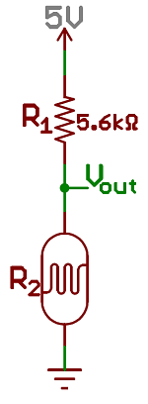
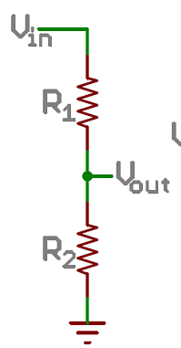
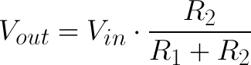
Voltage divider circuit

Slide 10
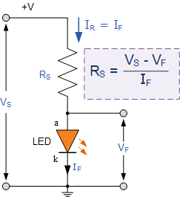
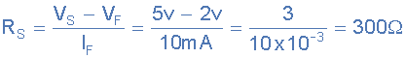
Voltage divider circuit
An amber coloured LED with a forward volt drop of 2 volts is to be connected to a 5.0v stabilised DC power supply. Using the circuit calculate the value of the series resistor required to limit the forward current to less than 10mA

Slide 11
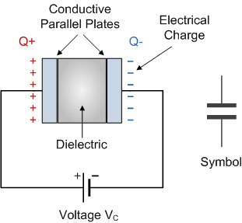
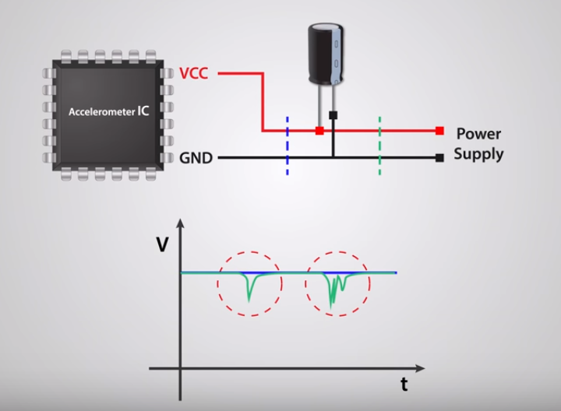
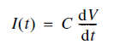
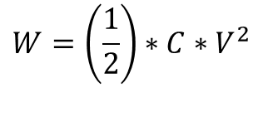
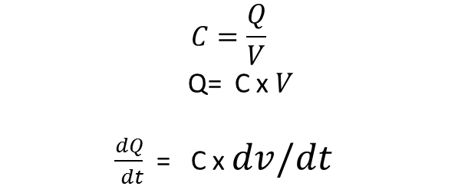
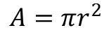
Capacitor
$$A=πr^{2}$$
$$C=\frac{Q}{V}$$
Q= C x $V$
$\frac{dQ}{ dt}$ = C x $dv/dt$
C = Q/V
C is Capacitance in Farad
Q is charge in Columb
V - Volts
$$W=\left(\frac{1}{2}\right)∗C∗V^{2}$$

Slide 12
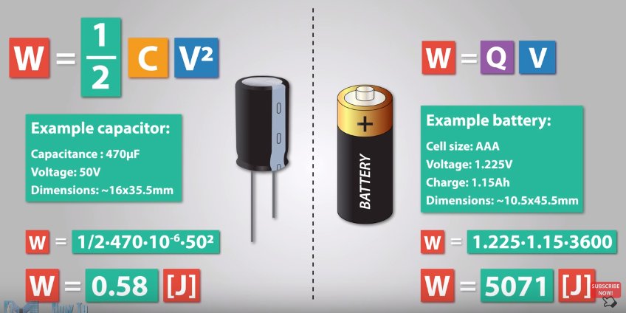
Capacitor

Slide 13
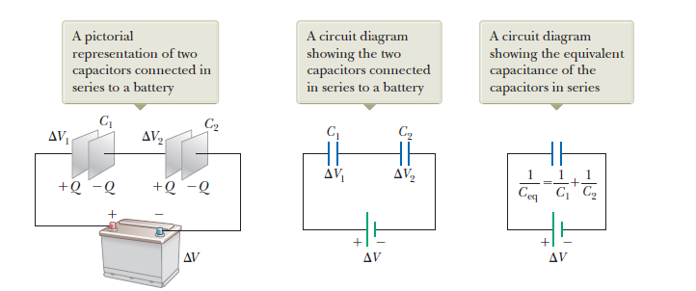
Capacitors in Series

Slide 14
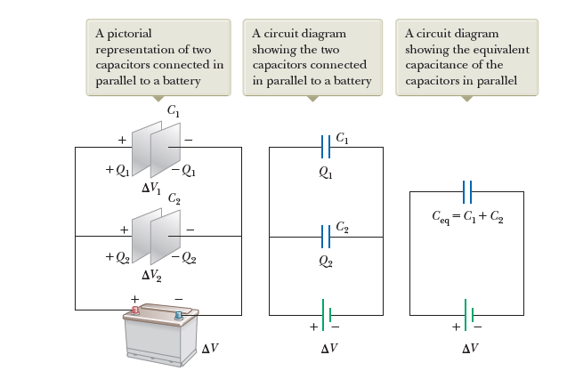
Capacitors in Parallel

Slide 15
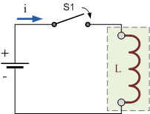
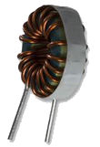
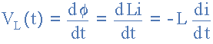
Inductors
Used as filters, motors, transformers etc,
An inductor opposes the rate of change of current flowing through it due to the build up of self-induced energy within its magnetic field.
Φ- Magnetic flux (Weber)
L – Inductance (Henry) i- Ampere
V - Voltage

Slide 16
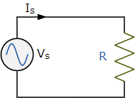
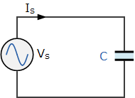
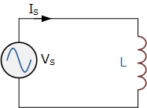
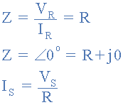
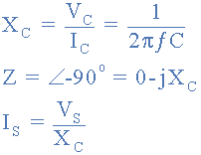
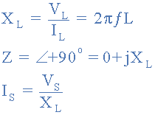
Circuits
Pure Resistance Circuit
Pure Capacitance Circuit
Pure Inductive Circuit
Unlike Resistor which just impedes the current (Constant Ohms), Capacitor and inductor impede currents (Variable ohms) based on frequency of power supply

Slide 17
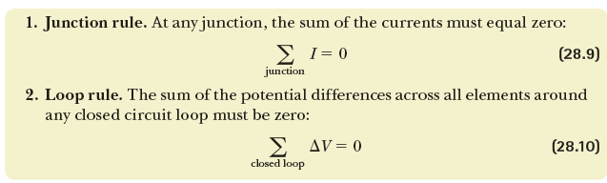
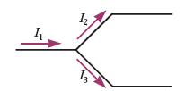
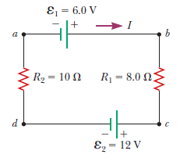
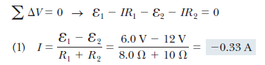
Kirchoff’s Law

Slide 18
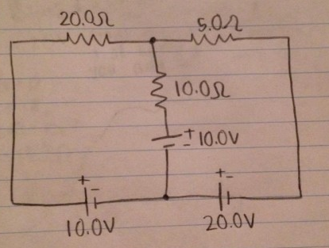
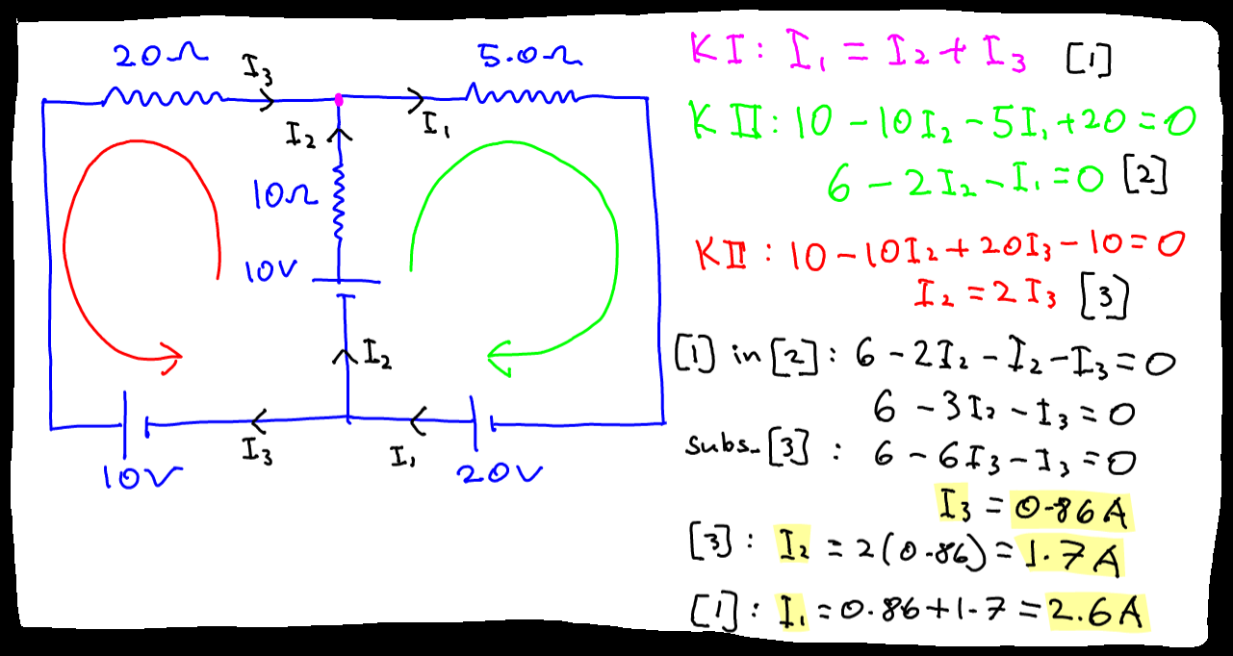
Kirchoff’s Law

Slide 19
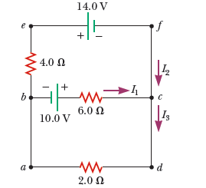
Kirchoff’s Law (Home work)

Slide 20
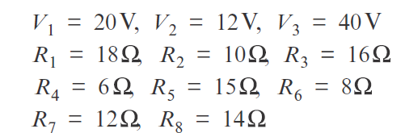
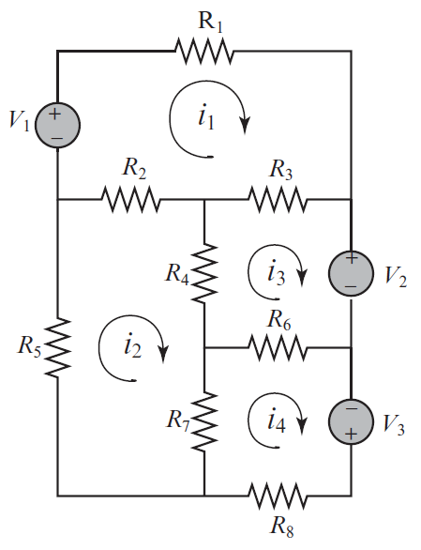
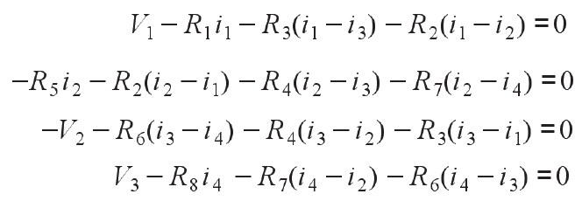
Kirchoff’s Law

Slide 21
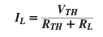
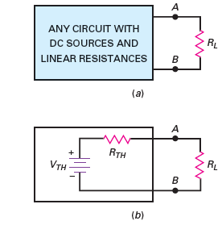
Thevenin’s Theorem
Thevenin voltage VTH is defined as the voltage across the load terminals when the load resistor is open
The Thevenin resistance is defined as the resistance that an ohmmeter measures across the load terminals

Slide 22
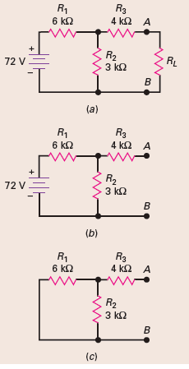
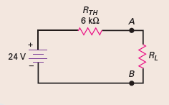
Thevenin’s Theorem

Slide 23
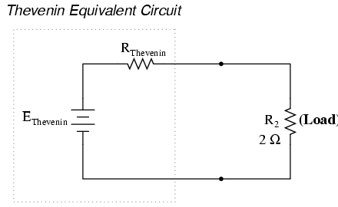
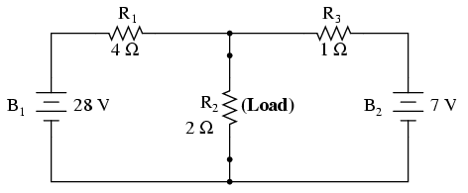
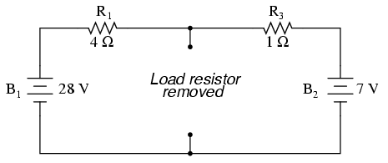

Thevenin’s Theorem

Slide 24


Magnetic field

Slide 25




Magnetic field

Slide 26




Magnetic field

Slide 27

DC motor

Slide 28

Spark Ignition system
https://www.youtube.com/watch?v=W94iksaQwUo

Slide 29


Conductor / Insulator
Neon atom, Poor conductor – Eight electrons in outer most orbit
Copper atom, Good conductor – One electron in outer most orbit

Slide 30


Semi conductor
Silicon Atom in the center surrounded by other 4 silicon atoms sharing one electron with center atom

Slide 31


Semi conductor
At room temperatures, valence electrons leave the orbit and their absence is marked by “ holes” (Positive charge)

Slide 32

Doping
Pentavalent atom
Pentavalent atoms have five electrons in the valence orbit. Examples of pentavalent atoms include arsenic, antimony, and phosphorus.
Because these materials will donate an extra electron to the silicon crystal, they are often referred to as donor impurities
Trivalent atom
How can we dope a pure silicon crystal to get an excess of holes?
By using a trivalent impurity, one whose atoms have only three valence electrons. Examples include aluminum, boron, and gallium.

Slide 33

Doping
N type Semi conductor
Trivalent impurities
holes
Pentavalent impurities
Electrons
P type Semi conductor

Slide 34


P-N Junction

Slide 35


P-N Junction

Slide 36

P-N Junction

Slide 37





Diodes

Slide 38


Diodes

Slide 39


Alternator Charging

Slide 40

Transistors (BJTs) – Bipolar Junction transistors
The emitter is heavily doped.
The base is lightly doped.
The doping level of the collector is intermediate, between the heavy doping of the emitter and the light doping of the base.
Why called as Bipolar?
Operation depends on Free Electrons and Holes

Slide 41



Transistors

Slide 42





Transistors
Conventional Current
Electron Flow
β_{dc} is the current gain of the transistor – A small base current controls much larger collector current

Slide 43

Transistors

Slide 44



Transistors

Slide 45

Transistors
Saturation – The transistor acts like a short circuit. Current freely flows from collector to emitter.
Cut-off – The transistor acts like an open circuit. No current flows from collector to emitter.
Active – The current from collector to emitter is proportional to the current flowing into the base.

Slide 46

Transistor as a switch

Slide 47



Field Effect transistors (unipolar)
Gate Voltage Controls Drain Current
Why called as Unipolar?
Operation depends on either Free Electrons or Holes
Much faster switching circuit than BJTs.

Slide 48

MOSFET

Slide 49


MOSFET
INPUT IMPEDANCE- Very high
Size – very small
Less noisy than bjt

Slide 50
MOSFET
INPUT IMPEDANCE- Very high
Size – very small
Less noisy than bjt
No thermal runaways

Slide 51
Digital Logic

Slide 52




AND Gate

Slide 53




OR Gate

Slide 54


NOT Gate

Slide 55

NOT Gate Hardware
When the transistor is off, no current flows through the collector-emitter path. In this way, the circuit’s output is HIGH when its input is LOW.
When voltage is present at the input, the transistor turns on, allowing current to flow through the collector-emitter circuit directly to ground. This ground path creates a shortcut that bypasses the output, which causes the output to go LOW.
In this way, the output is HIGH when the input is LOW and LOW when the input is HIGH.
5 Volts

Slide 56



NOT Gate (CMOS)
PMOS
5
5
5(1)
1
0
0
NMOS

Slide 57


NAND Gate (AND + NOT)

Slide 58


NOR Gate (OR + NOT)

Slide 59



XOR (Exclusive OR)
NAND
OR

Slide 60

Arrangement
AND
NOR

Slide 61


Boolean Algebra

Slide 62


Boolean Algebra
AND
OR

Slide 63
De Morgan’s Law *
A + B = A . B
A . B = A + B

Slide 64



Boolean Algebra to simplify the gates

Slide 65


De Morgan’s Law *

Slide 66


Example
An electronic switch that uses digital logic is to be developed for switching the lights on and off in an art gallery. The switch has to be turned on at 7:00 p.m. and turned off at 6:00 a.m. Also, if there are people in the gallery and the light that enters the gallery from outside is inadequate, the lights have to be turned on regardless of the time of the day.
There are 3 sensors (Human, Light, Timer) – Timer goes high if time is between 6.00 AM to 7.00 PM. Human sensor goes high when people are there and light sensor goes high when light is inadequate
The logic state of the people sensor is denoted by p, that of the light sensor is denoted by l, and that of the time sensor is denoted by t.
P
s
l
t

Slide 67


Voltage chopping

Slide 68



Thyristor (SCRs)

Slide 69


Thyristor (SCRs)
By accurately varying the timing relationship between the Gate pulse and the positive half-cycle, the Thyristor could be made to supply any percentage of power desired to the load, between 0% and 50%

Slide 70

Triacs

Slide 71
Thank you

